Slide 1
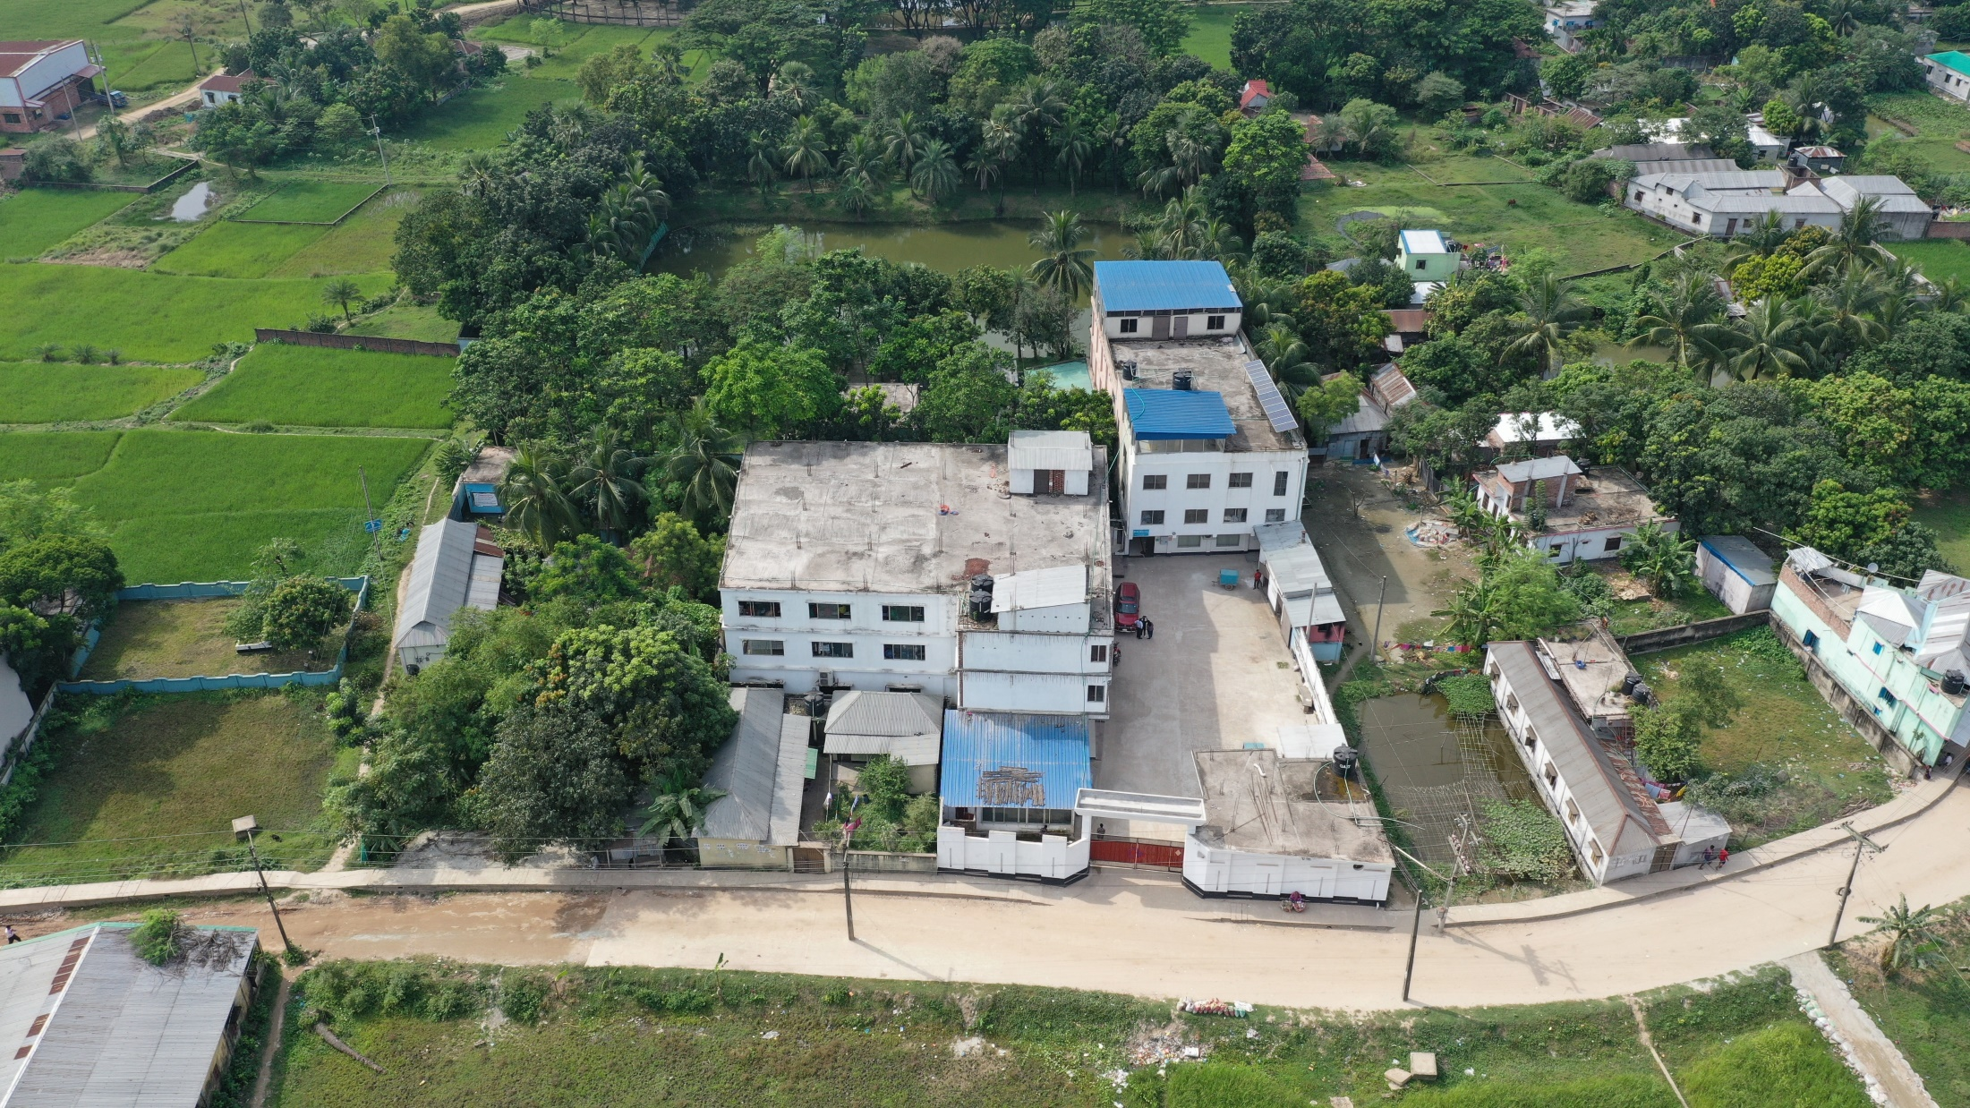
Welcome to M R SWEATER
(100% EXPORT ORIENTED SWEATER MANUFACTURING COMPANY)
ESTABLISHED: 2017

Slide 2
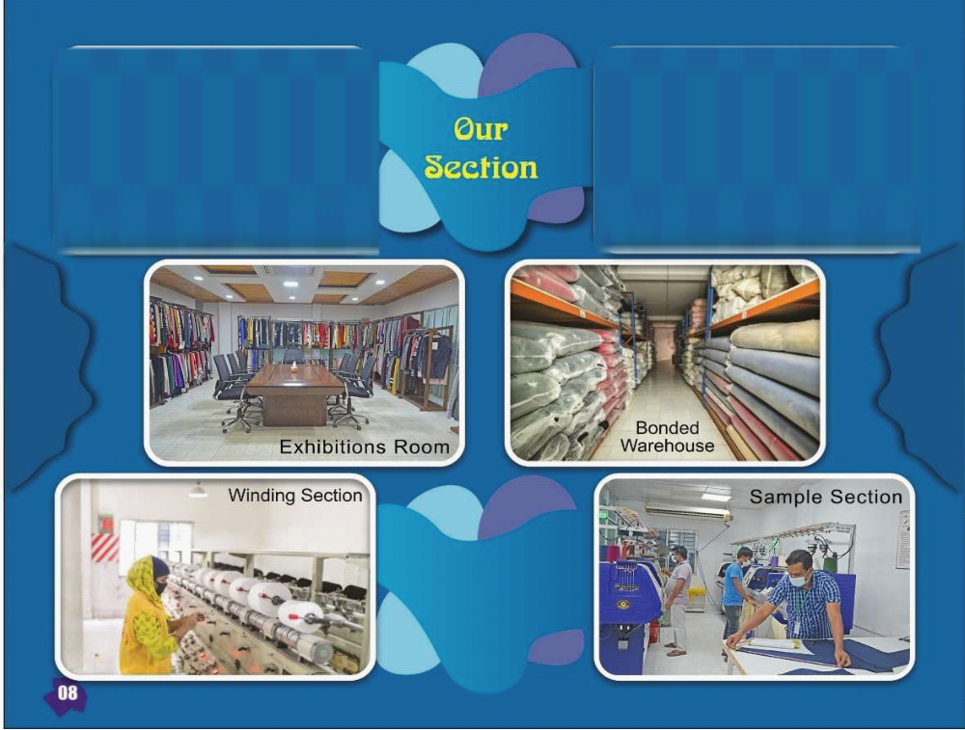

Slide 3
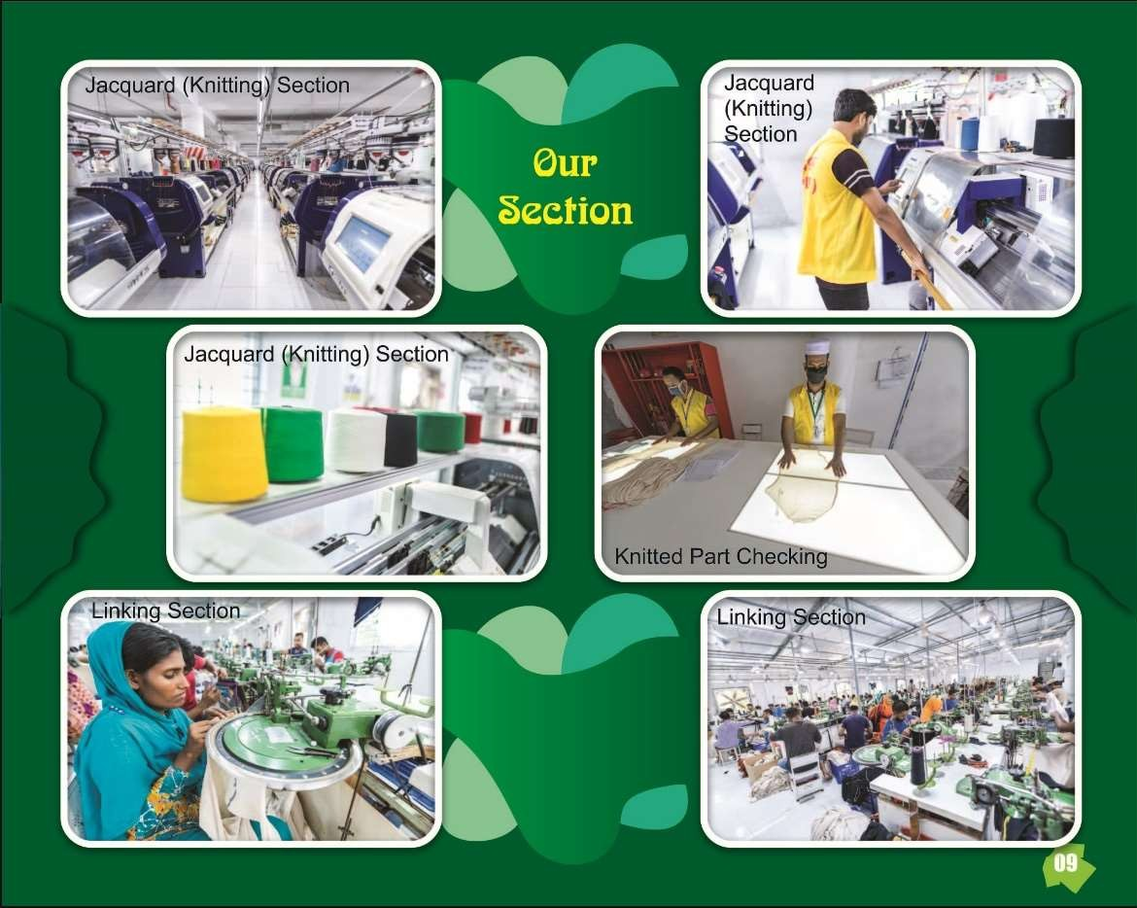

Slide 4
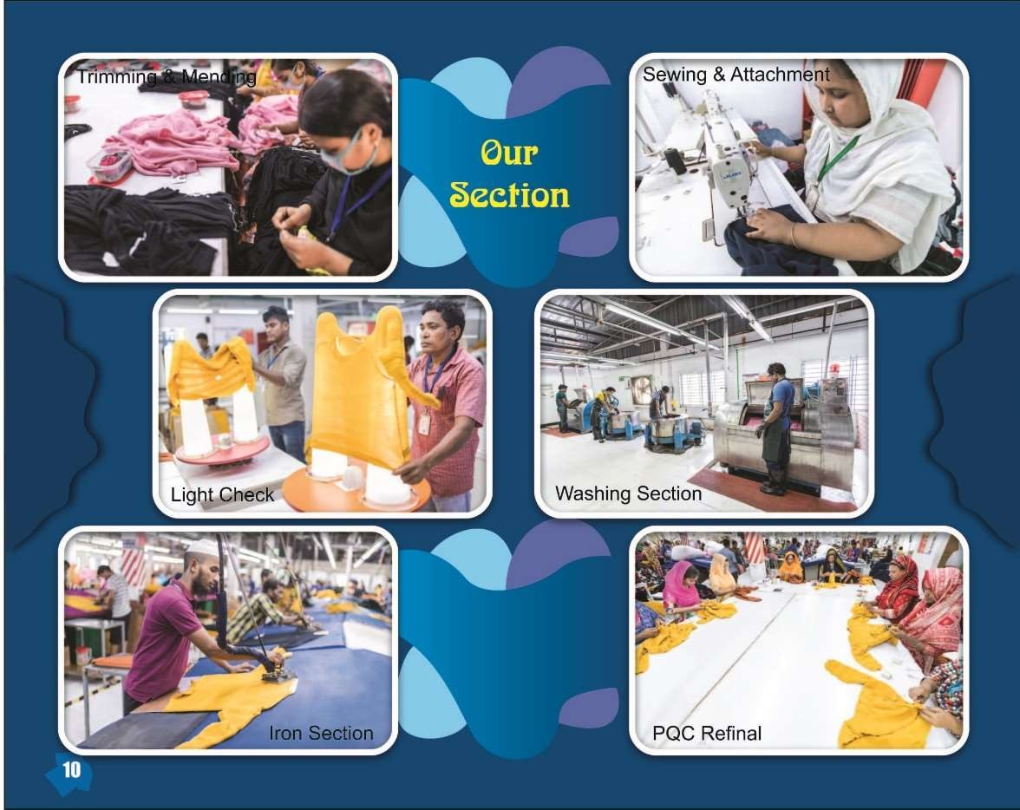

Slide 5
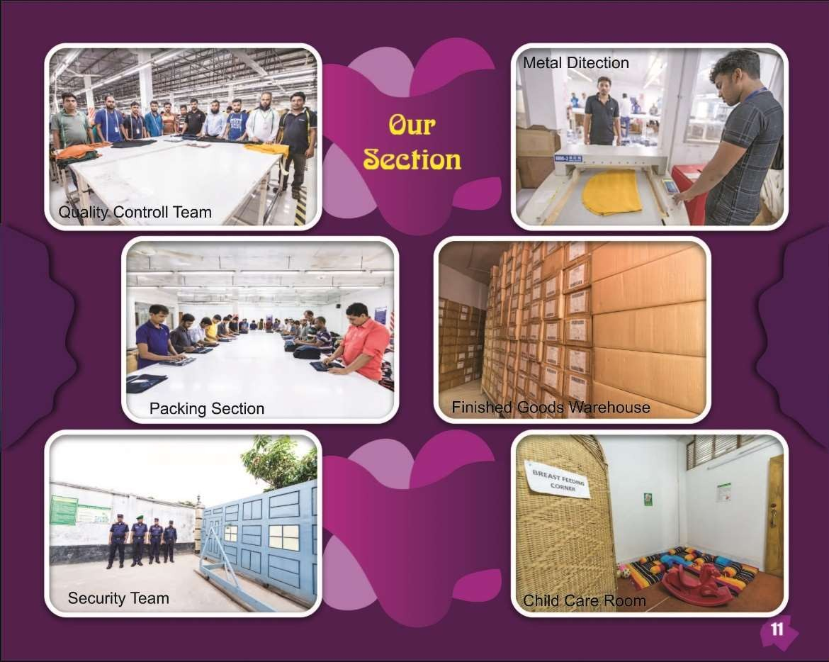

Slide 6
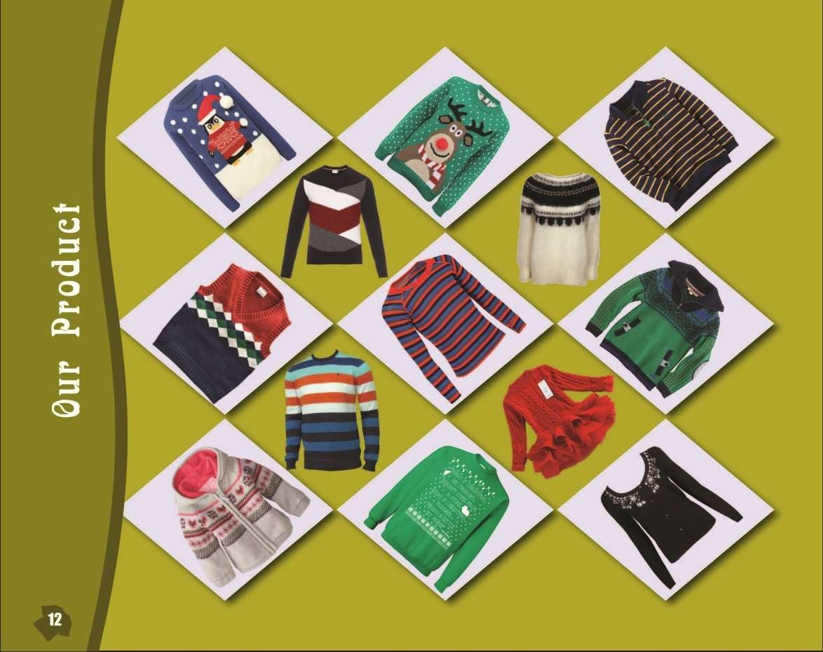

Slide 7
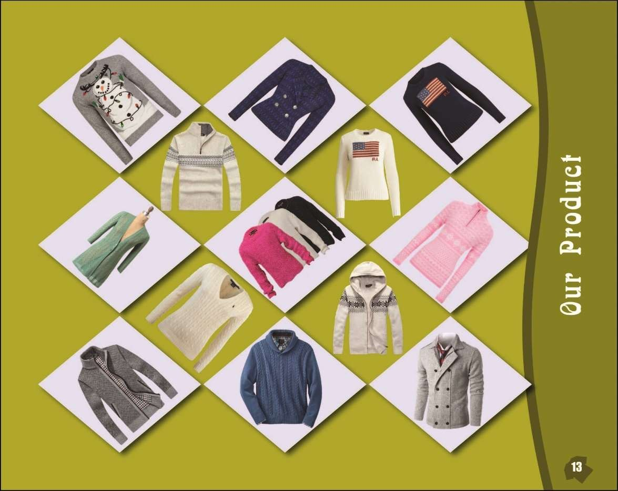

Slide 8
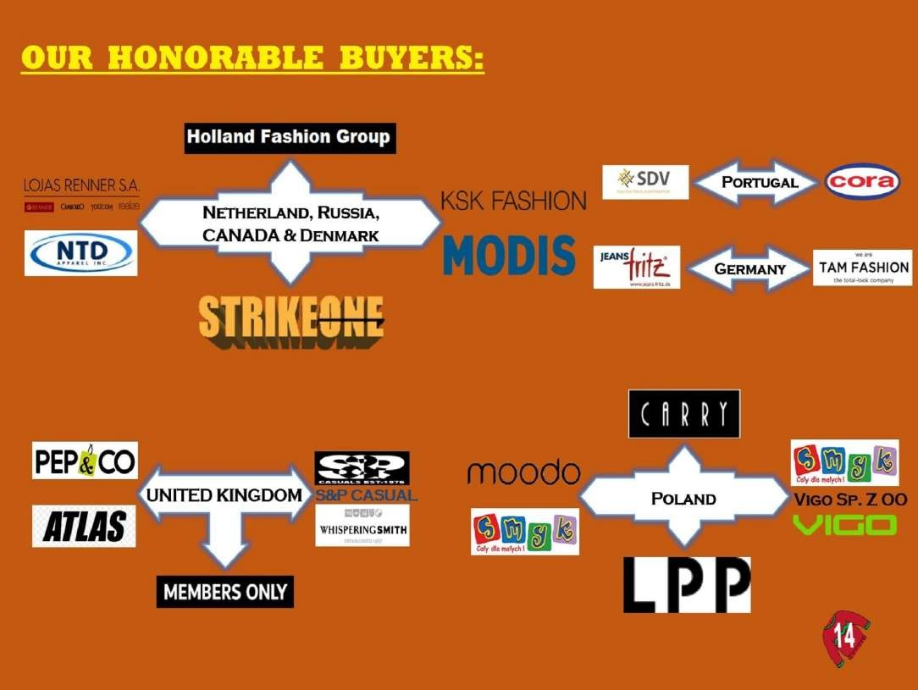

Slide 9
it give me pleasure to introduce M R SWEATER. From a humble start in 2017 with our sincere effort M R emerged to be a leading textile base for future.
Presently around 410 workers & employees are working as well as we have experience mid Level management, technician and capable workforce to produce best quality products.
Our mission
To establish the best & the most efficient manufacturing facilities in the country to ensure total satisfaction of Customer by offering quality product and on time delivery at competitive Price.
Our vision
Our Company vision is to provide products and services of high consistent quality ensuring maximum value and satisfaction to our customers through effective utilization of time and adoption of superior design, cost effectiveness, appropriate technology and talents of our work force.

Slide 10
About us
M R Sweater has 44,000 sq-ft of production area with all modern facilities present. All its major departments like marketing, planning, procurement, finance, shipping are in its head office at Dhaka. The production team is comprised of skilled labors & most of the workers are men who are leading to dissolve men unemployment in Bangladesh. The managerial staff consists of a combination of national & international professionals providing us necessary inputs to compete in post M F A era. The corporate culture of M R Sweater is transparent and it’s business policy promotes its employees to grow along with the organization.
Product Range
M R Sweater managements are involved in this trade from last one decade. They know the changes of fashion trends & accordingly M R sweater has been started in terms of machinery & technology. M R sweater is ready to do any kind of silhouettes like halter, tank top to coats, jackets.
M R Sweater has got its expertise to do planting with lycra to give a proper shape to the fitted garments. Style with embroideries and printings are some added value addition to their range. M R Sweater is pioneer in acid wash, enzyme wash, distress look sweater which are the most recent trend in fashion. We have our own tie up with unique dyeing washing plant & Ring shine for these moist trend fashions

Slide 11
Raw Material
Raw materials are the most important element in the creation of best product. We always deal with almost all types of yarn starting from natural fibers like wool, woolen blends, cotton blends to man made fibers like viscose, nylon & acrylic & their blend based on deliveries & quality preferences. We source yarn from Bangladesh, China, Korea, and Taiwan.
Products & Developments
Sampling section of M R sweater is equipped with all kinds of machineries to fulfill its buyer’s need at any point of time. Experienced designers & skilled workers in sampling department enables quick turn around of sampling request. Organization product prototyping to translating concepts into collection, all done here professionally with the help of technically experienced professionals. Huge database of yarn, trims & accessories always lead to timely deliveries of all samples.
Quality Assurance
M R Sweater has its own quality assurance system to make top quality sweater. Quality assurance & quality efficiency monitoring system reduces the rework & hence improve the product efficiency as well as identify operators who require more training to meet requirements. Checkpoints at all process end ensure better quality product. Testing of raw materials for physical & chemical characteristics by reputed textile testing laboratories ensures that the materials are of high standard. In house QA team carries out random in-house final inspection of the packed goods before conducting final inspection by buyer’s QA. So, our quality is without question. We pay special attention for quality and best services. We follow AQL 1.5 for inline and 2.5 for final inspection.
Workflow & Technologies
Production planning, production targets based on sample are product engineering department to ensure timely deliveries. Implementation of proved production tracking system along with production efficiency monitoring system.

Slide 12
· Winding Machine (12 Spindle ) |  | 10 Sets
· Computerized Jacquard knitting machine (12gg) |  | 84 Sets
· Computerized Jacquard knitting machine (Multi gauge) |  | 78 Sets
· Dial linking Machine (brand – Universal) 14gg |  | 60 Sets
· Dial linking Machine (brand – Universal) 08gg |  | 30 Sets
· Dial linking Machine (brand – Universal) 06gg |  | 30 Sets
· Auto Strap knitting machine ( brand-Flying Tiger ) |  | 02 Sets
· Over lock Machine (brand-Juki) |  | 03 Sets
· Lock Stitch Machine with Thread trimmer( brand– Juki ) |  | 01 Sets
· Electronic Button Machine (brand – Juki) |  | 02 Sets
· Electronic Bar tac Machine (brand – Juki) |  | 02 Sets
· | Automatic Washing Machine | 01 Sets
· | Hydro Extractor | 01 Sets
· Tumbler Dryer (Capacity- 200 Lbs Origin – Hong kong) |  | 03 Sets
· Steam Boiler (capacity – 500kg) |  | 01 Sets
· | Vacuuming Iron Table | 20 Sets
· | Brushing Machine | 01 Sets
· | Sewing Machine | 12 Sets
· | Generator (310KVA & 125 KVA) | 02 Sets

Slide 13
Production Capacity
As an emerging sweater-manufacturing unit, M R Sweater has a good capacity in 3, 5, 7 & 12GG.The present production capacity of about 1,00,000 pcs per month, Gauge wise
break down of the production capacity is as follows:
12GG steiger( Jacquard) 60 nos -- > 55,000 pcs/month
12gg giant start (jacquard) 24 nos --- > 20,000 pcs/month
5&7GG GIANT STAR 30 Nos --- > 20,000 pcs/month
3.5,5&7gg Multi (Jacquard) stoll 24 Nos -- > 30,000 pcs
MULTIGG STEIGER(jacquard) 24 nos -- > 26,000 pcs
Total production Month: 1,50,000 pcs
Total production year : 18,00,000 pcs (approximate)

Slide 14

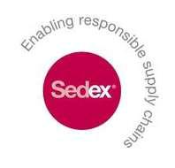
Certificates
Certificates
DBID: 398513
[On process..]

Slide 15
Our Clients
Our Clients
LOSAN - Spain
Cora – France
LMA-Lebeurre-France
Aulas et fils sas-France
G&W – USA
Mirabbo-Spain
Marc-Lauge –Denmark
8. Conbipel – Italy
9. Coppel – Mexico
10. Jeans Fritz – Germany
11. MODIS – Russia
12. Full Circle Trends– USA
13. Holland Fashion – Netherlands
14. Diverse – Poland
Toko Suji – Japan
Oracon – Brazil
17. Golden Touch Inc - USA

Slide 16
Contact Person
MANAGING DIRECTOR
MD Mokhlesur Rahman
DIRECTOR
Miss. Raya Rahman.
Cell : +8801714072762
E-mail : rayarahman@mrsweaterltd.com
EXECUTIVE DIRECTOR :
MD. Masud Karim Shamim
Cell : +8801924040440/
0186996688
E-Mail: shamim@mrsweaterltd.com
CHIEF EXECUTIVE
Sirajul Islam Siraj
Cell: +88 01713040326
E-Mail: siraj@mrsweaterltd.com
GENERAL MANAGER:
Manab Saha
Cell : +8801711660225,01921683377
E-mail : manab@mrsweaterltd.com
Factory
538/1 Kamarjuri,
National University,Gazipur Sadar ,Gazipur, Bangladesh .
E-mail – rayarahman@mrsweaterltd.com
Phone : +8801714072767,
Head Office
M R Sweater
House No: 02, Road No : 17, Sector No: 13, Uttara Model Town Dhaka-1230, Bangladesh.
Our Bank name & address
A B Bank.
Uttara Branch
Uttara ,Dhaka, Bangladesh
A/C No : 4020 766952 000
Swift code: ABBL BDDH 020
Dutch Bangla Bank Ltd.
Banani Branch.
Banani, Dhaka, Bangladesh
A/C No : 103110 0044321
Swift code: DBBL BDDH 103

